Slide 1

GradeForecast Presentation
Done By – Mohammed Jasim

Slide 2

Rational Statement
This analysis addresses the need to identify the optimal predictive model for student outcomes using educational variables. The dataset contains teaching method, satisfaction, study time, ability scores, and previous performance metrics to predict binary success/failure outcomes.

Slide 3
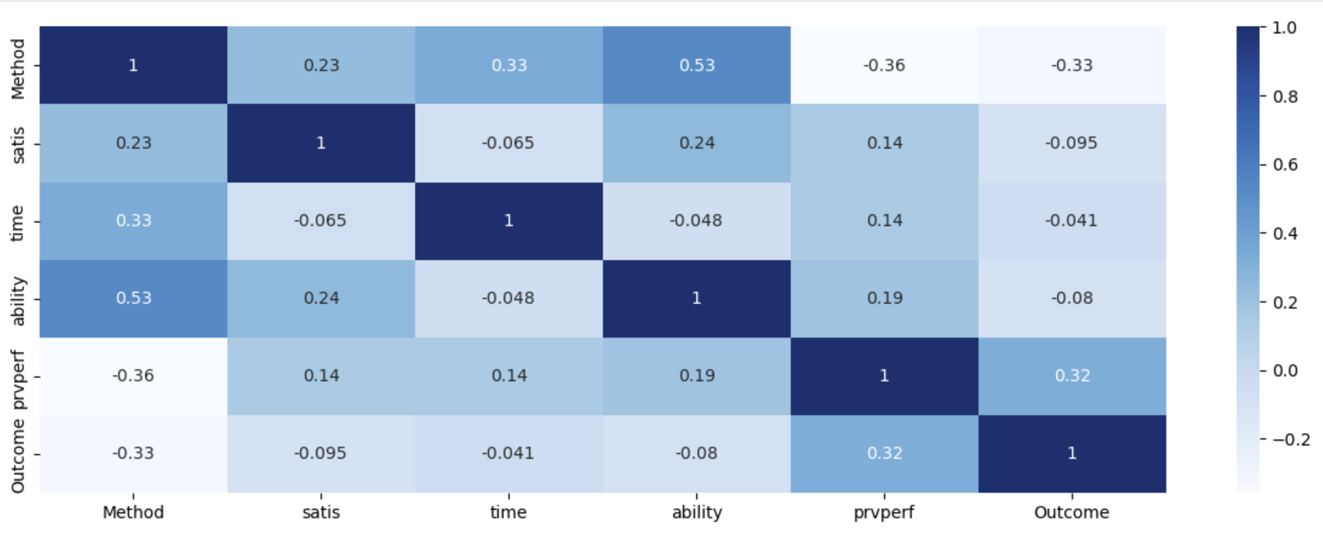
Correlation Heatmap

Slide 4

Insights from Correlation Heatmap
Strong Positive Correlation Between Ability and Outcome: The heatmap shows that student ability has a significant positive correlation with the outcome variable, indicating that higher ability scores are strongly associated with successful outcomes (Class 1).
Previous Performance Correlation: Previous performance ("prvperf") also demonstrates a notable positive correlation with the outcome, suggesting that past academic achievement is a good predictor of future success in this dataset.

Slide 5
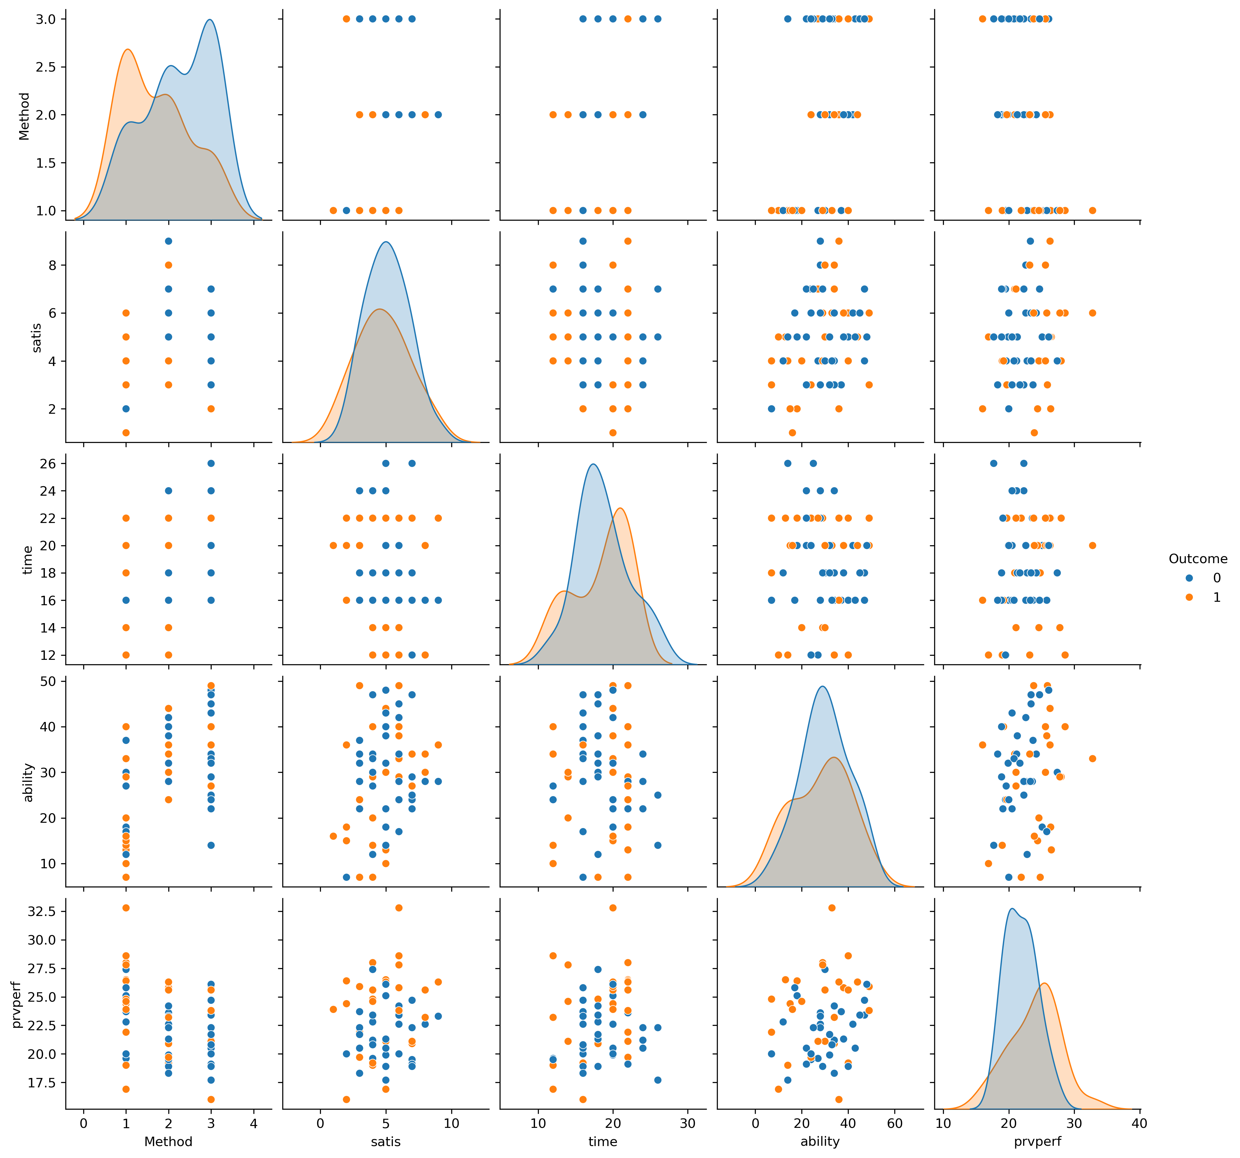
Pair Plot

Slide 6

Insights from Pair Plot
Class Separation in Ability Variable: The pair plot reveals clear separation between Class 0 and Class 1 along the ability dimension, reinforcing the correlation findings that ability is a strong discriminating factor.
Method and Satisfaction Relationship: There appears to be a pattern in how teaching methods (Method variable) interact with satisfaction levels (satis), with certain methods yielding higher satisfaction scores for successful outcomes (Class 1).

Slide 7
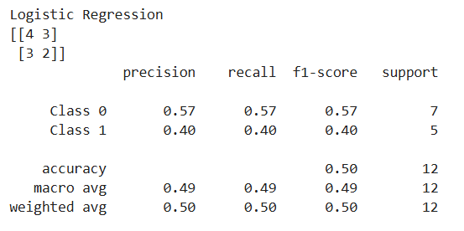
Logistic Regression

Slide 8
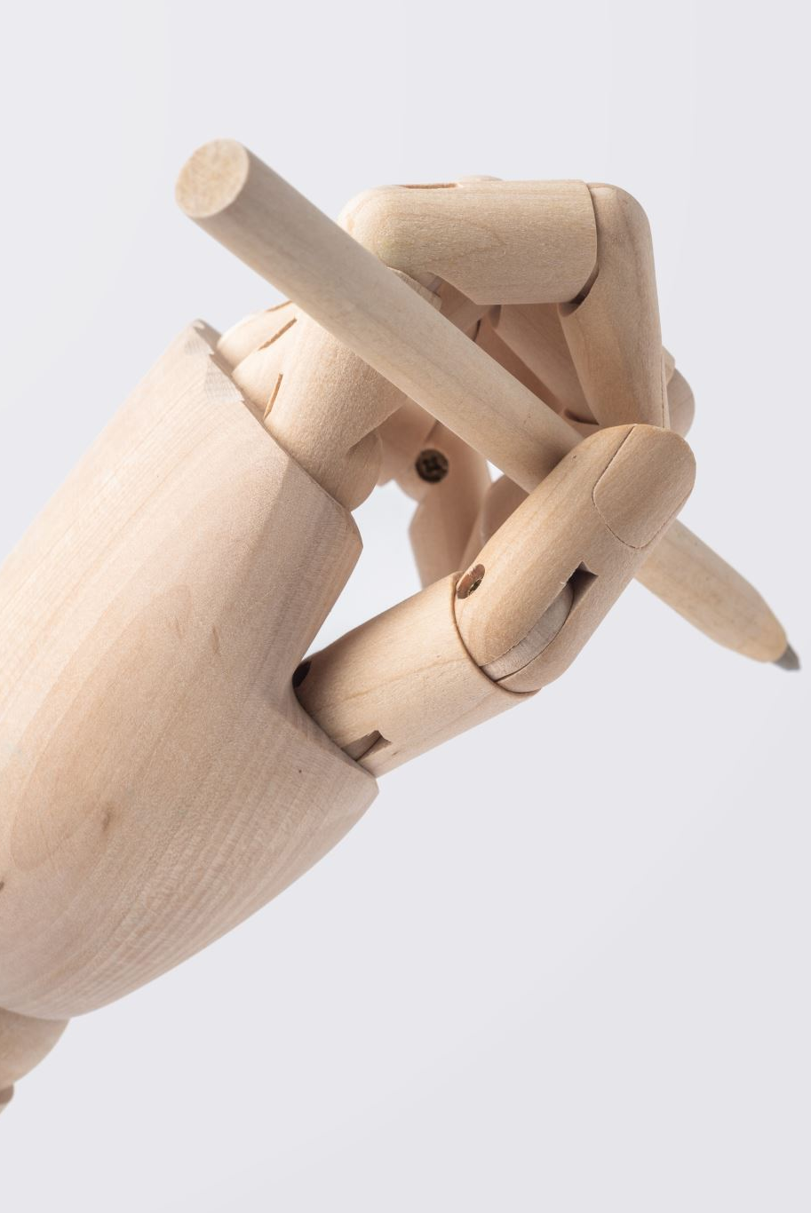
Insights from Logistic Regression
Balanced but Mediocre Performance: The model shows identical precision and recall values (0.57 for Class 0, 0.40 for Class 1), indicating consistent but moderate performance.
Lower Overall Accuracy: With only 50% accuracy, this model essentially performs no better than random chance on this dataset.
Poor Positive Class Prediction: The model struggles with correctly identifying Class 1 instances, with only 40% precision and recall for the positive class.

Slide 9
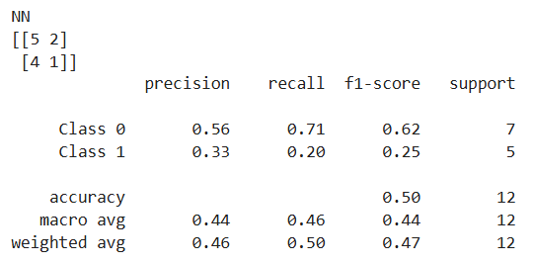
Neural Network

Slide 10
Insights from Neural Network
Class Imbalance Handling: The Neural Network shows a strong bias toward predicting Class 0, with high recall (0.71) but very poor performance on Class 1 (0.20 recall).
Lowest F1-Score for Class 1: With an F1-score of only 0.25 for Class 1, this model performs worst at balancing precision and recall for the positive class.
Overfitting Concerns: The significant disparity between Class 0 and Class 1 performance suggests the neural network may be overfitting to the majority class in this small dataset.

Slide 11
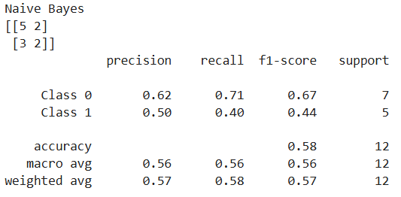
Naïve Bayes

Slide 12
Insights from Naïve Bayes
Highest Overall Accuracy: Naïve Bayes achieves the highest accuracy at 58%, outperforming both Logistic Regression and Neural Network models.
Better Class Balance: This model shows the most balanced performance between classes with reasonable precision and recall for both Class 0 and Class 1.
Strong True Negative Rate: The model correctly identified 5 out of 7 Class 0 instances (71% recall), showing good ability to identify negative cases.

Slide 13
Model Recommendation
I recommend the Naïve Bayes model for implementation. This recommendation is justified by:
Superior Overall Performance: It achieves the highest accuracy (58%) and the best weighted average F1-score (0.57) among all three models.
Better Class Balance: Unlike the Neural Network which heavily favors Class 0, the Naïve Bayes model maintains reasonable performance across both classes.
Simplicity and Interpretability: Naïve Bayes models are generally more interpretable and require less computational resources compared to Neural Networks, making them more practical for deployment in educational settings.

Slide 14
Recommended Improvements
To enhance the usability of the Naïve Bayes model, I recommend:
1. Optimize Probability Thresholds The model shows an imbalance in prediction performance between classes (Class 0: 0.67 f1-score vs Class 1: 0.44 f1-score). Recommendation: Adjust the classification probability threshold from the default 0.5 to a value that better balances precision and recall for both classes. This can help improve the model's performance on the underrepresented class without requiring additional data. 2. Implement Class Weighting Recommendation: Complement the threshold optimization with appropriate class weighting:
Assign higher weights to the underperforming Class 1 during model training
Use the class_prior parameter in Naive Bayes to specify custom prior probabilities
Create a balanced evaluation metric that considers the importance of both classes
This approach works hand-in-hand with threshold adjustment to address the class imbalance issue identified in point 1, providing a more comprehensive solution to improve overall model performance.

